Slide 1


Fun with JUnit Testing, Navigating, and Innovating!
Under the supervision of
Ali Imanifard
Mr. S-H. Mirian

Slide 2

Table of Contents!
JUnit Journey Kickoff
Advanced Testing Insights
Testing Essentials
DO NOT SLEEP !!!!!!
Introduction to JUnit
Getting Started with JUnit
Other Advanced Features
Best Practices and Tips
Assertions in JUnit
Test Suites & Test Runners
Testing a real application
Versatile Testing Techniques
Wrap-Up & Resources
Parameterized Tests
Test Fixtures
Conclusion & Resources

Slide 3

01
JUnit Journey Kickoff
Introduction to JUnit
Getting Started with JUnit

Slide 4

Introduction to JUnit
JUnit:
Imagine JUnit as a superhero swooping in to save your code from bugs and errors!
JUnit is a popular Java testing framework that enables developers to write and run automated tests efficiently.
A robust tool for test automation to detect defects early and ensure code reliability.

Slide 5
Why JUnit Matters
JUnit: Your Trusty Sidekick
Just like every superhero needs a reliable sidekick, every Java developer needs JUnit by their side.
Automated testing with JUnit ensures code quality, catches bugs early, and provides confidence in your software.
It's like having a second pair of eyes reviewing your code, but faster and more consistently.

Slide 6

Getting Started with JUnit
Setting Up Your JUnit Lab
To begin your JUnit journey, you'll need to set up a Java project with JUnit dependencies.
Think of it as building your own superhero lab, equipping yourself with the tools to fight against bugs.
Add the JUnit library to your project's classpath and you're ready to go!
Generated by Copilot

Slide 7
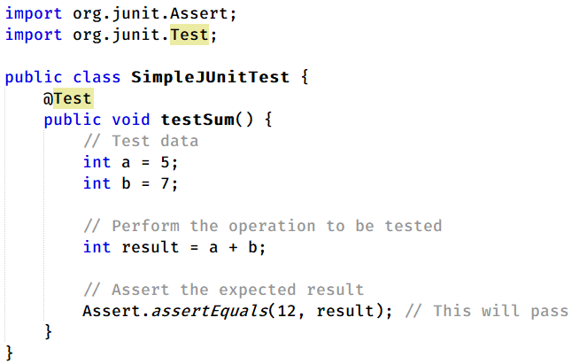
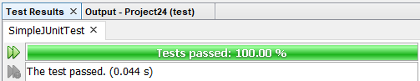
The Power of @Test
By marking a method with `@Test`, you declare it as a test case that JUnit will execute.
It's like activating your superhero powers, ready to tackle any challenge your code throws at you.

Slide 8
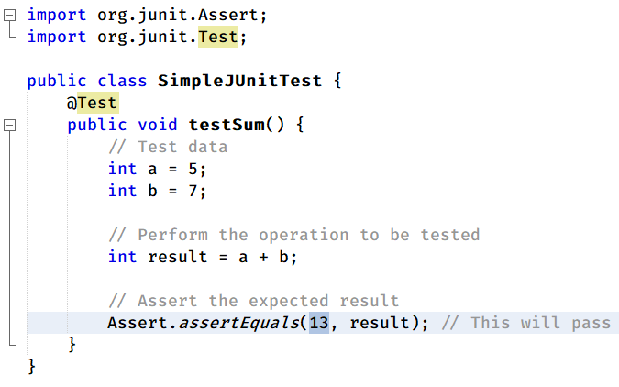
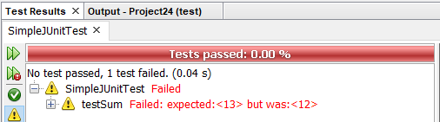
The Power of @Test
By marking a method with `@Test`, you declare it as a test case that JUnit will execute.
It's like activating your superhero powers, ready to tackle any challenge your code throws at you.

Slide 9
02
Testing Essentials
Assertions in JUnit
Test Suites & Test Runners

Slide 10


Generated By Copilot
Assertions in JUnit
Assertions are the ‘truth seekers’ of effective unit testing.
Statements that validate conditions in test cases.
Verify expected outcomes against actual results.
JUnit provides a wide range of assertion methods.
Without assertions, tests are incomplete and lack purpose.

Slide 11
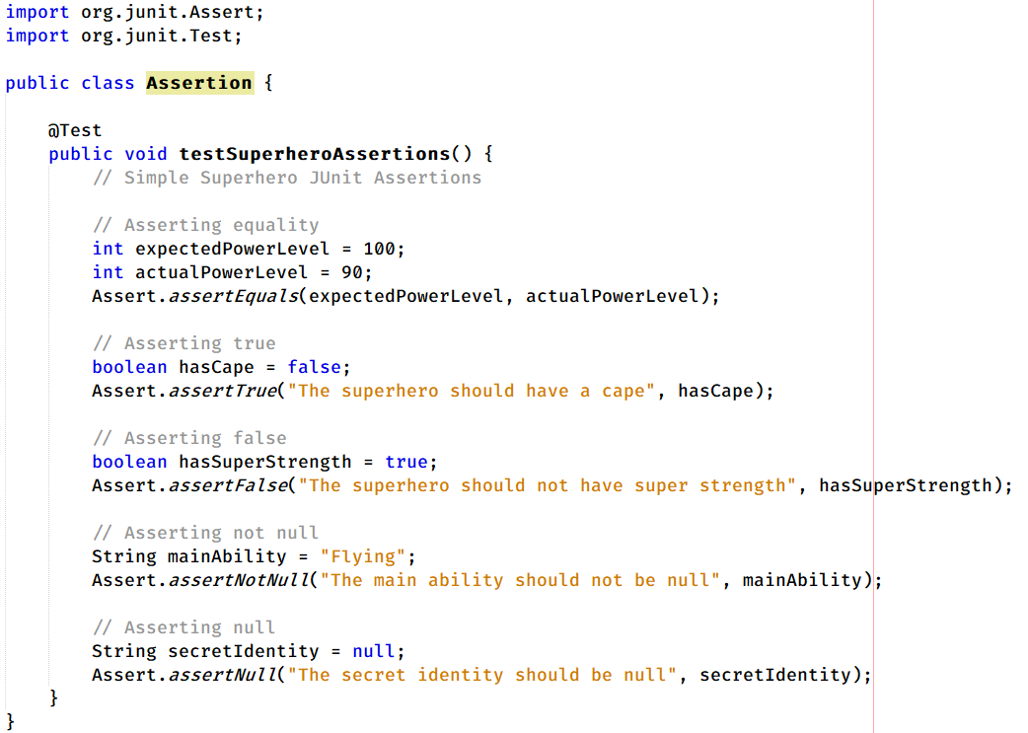
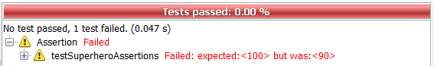
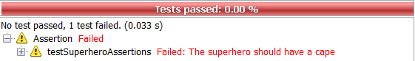
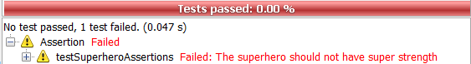
Assertion Example: Let's Have Some Fun!

Slide 12


Test Suites: Assembling Your Testing Avengers
@Suite
Test suites group related test cases together
They provide a logical organization for your tests
Test suites allow you to run multiple tests as a single unit
JUnit test suites are defined using the `@Suite` annotation
Generated By Copilot

Slide 13

Test Runner: The Unsung Hero
The JUnit test runner is responsible for executing your tests.
It discovers and runs the tests in your test classes.
The test runner provides feedback on test results.
You can run tests using IDEs, build tools, or the command line
Generated By Copilot

Slide 14
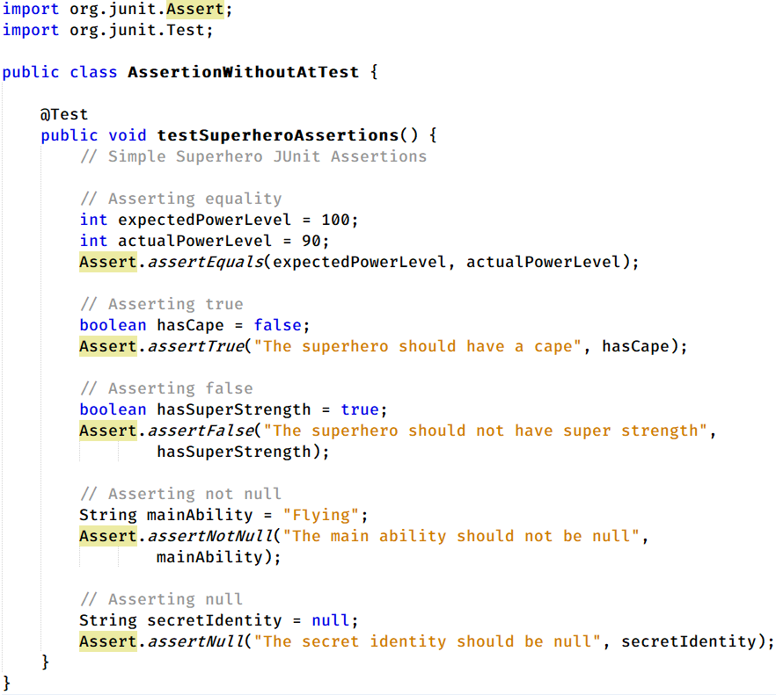
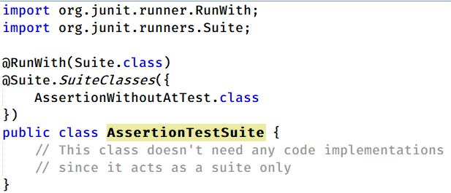
Creating and Running Test Suites in JUnit

Slide 15
03
Versatile Testing Techniques
Parameterized Tests
Test Fixtures

Slide 16

Parameterized Tests
Enables testing multiple scenarios with a single test function
Saves time, reduces code duplication, and improves readability
Test various inputs effortlessly: valid, invalid, boundary cases
Emerge victorious with comprehensive test coverage

Slide 17
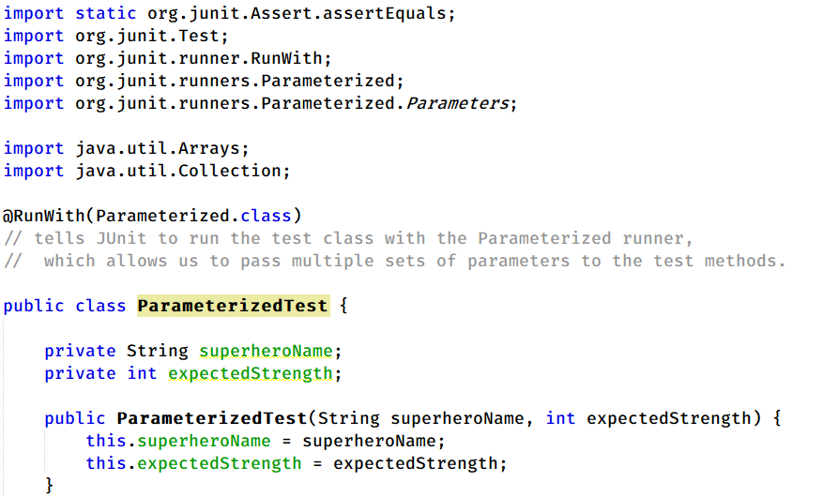
Parameterized Tests

Slide 18
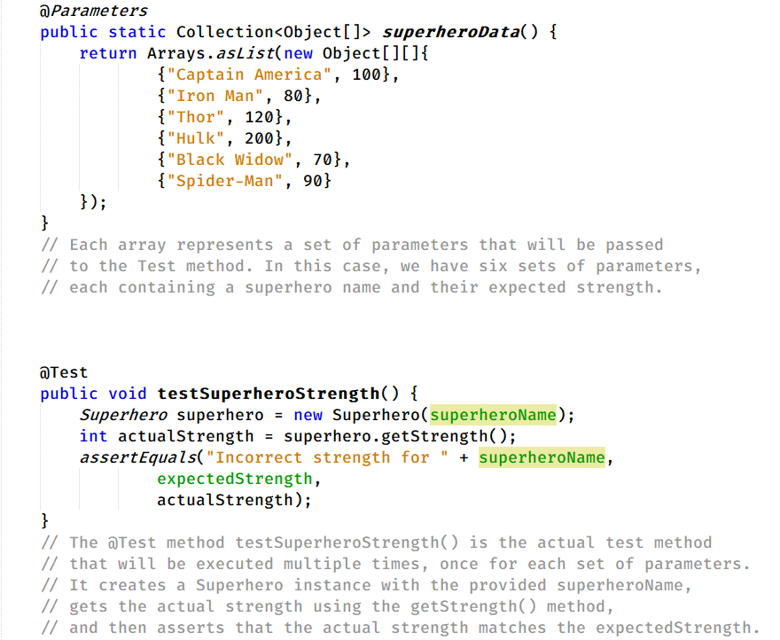

Slide 19
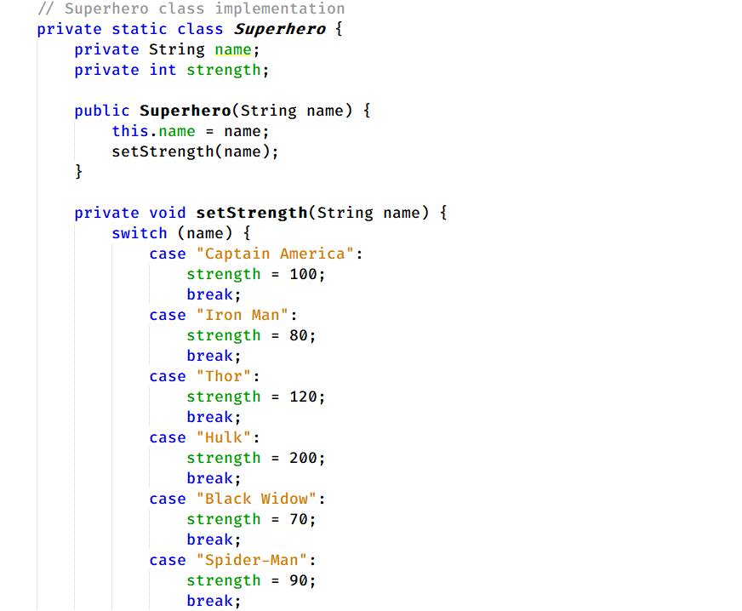

Slide 20
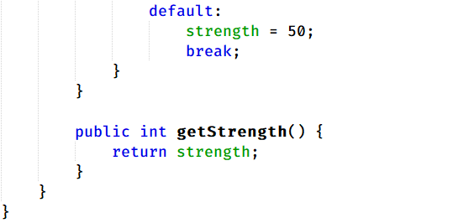
JUnit will execute the testSuperheroStrength() method six times
each time with a different set of parameters from the superheroData() method.
This way, you can test multiple scenarios with different inputs without duplicating test code.

Slide 21
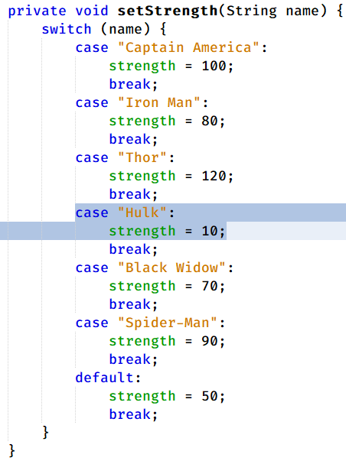
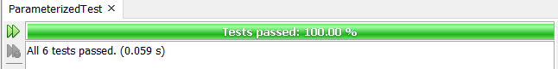


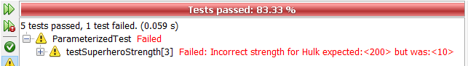
Hulk is the strongest!
Generated By Copilot

Slide 22
Test Fixtures
According to legends, in the software testing unveiling ceremonies,
Test fixtures were the loyal servants preparing the stage
They set up the necessary preconditions for each test case (Before)
After the test, they tidied up, leaving no trace behind
Their dedication ensured the smooth running of the test

Slide 23
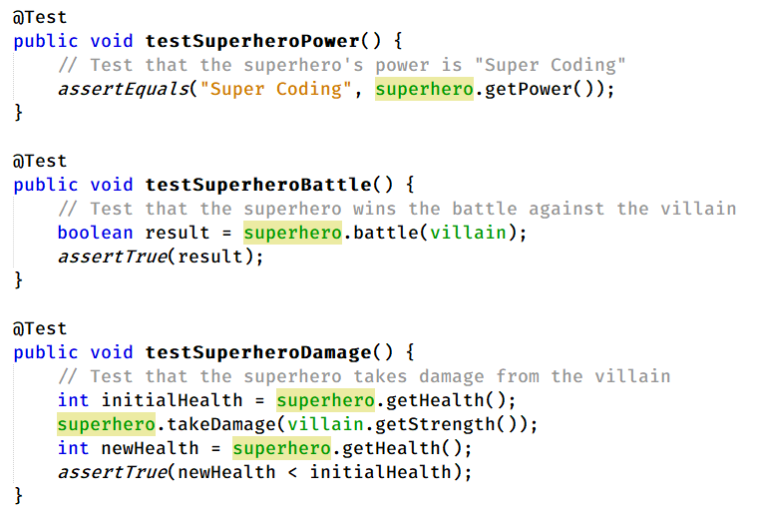
Test Fixtures Example
In this example, we have a Test class that contains three test methods:
1. testSuperheroPower
2. testSuperheroBattle
3. testSuperheroDamage
These test methods verify different aspects of the Superhero class and its interaction with the Villain class.

Slide 24
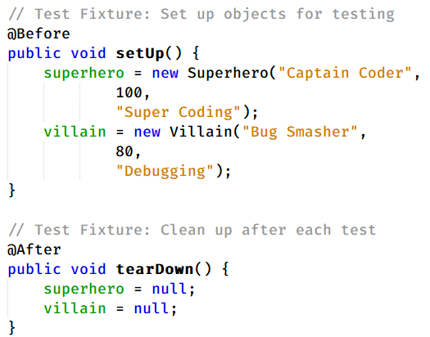
Test Fixtures Example
The @Before and @After annotations are used to define Test Fixtures.
The setUp method, annotated with @Before, is executed before each test method. In this method, we create instances of Superhero and Villain objects that will be used in the test methods.
The tearDown method, annotated with @After, is executed after each test method. In this method, we set the superhero and villain objects to null, effectively cleaning up the test environment for the next test.

Slide 25


Test Fixtures Example
By using Test Fixtures, we ensure that each test method has a consistent and predictable starting state
we clean up any resources or objects used in the tests after each test method completes.
This approach helps to isolate the tests and prevent them from interfering with each other, making the test suite more reliable and maintainable.
Generated By Copilot

Slide 26
04
Advanced Testing Insights
Other Advanced Features
Best Practices and Tips

Slide 27
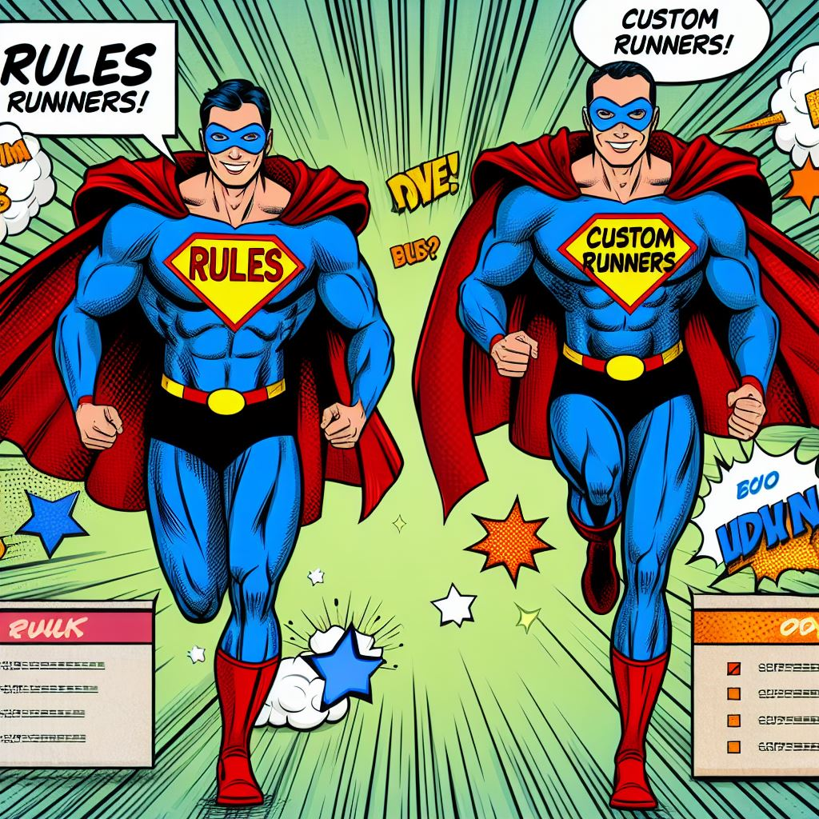
JUnit Rules
JUnit Custom Runners
JUnit Rules act like sidekicks, enhancing tests with additional capabilities.
TemporaryFolder Rule: No trace left behind, like a superhero's hidden lair!
ErrorCollector Rule: Gather all foes (errors) before taking them down in one swoop!
Build your own superhero suit (test runner) to fit your unique mission (testing requirements).
Generated By Copilot

Slide 28
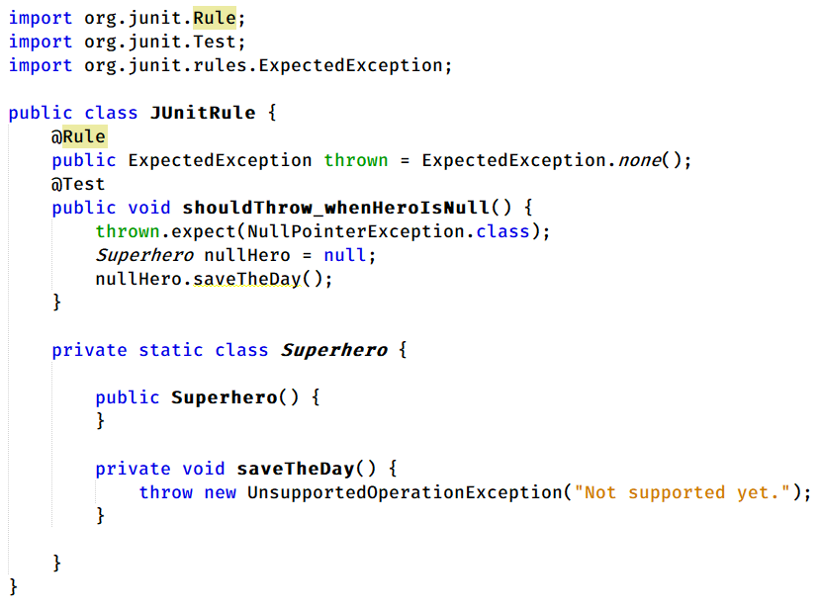
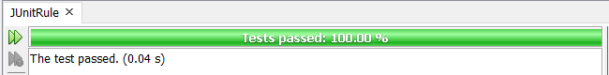
JUnit Rule Example
The JUnit test case is testing exception handling behavior.
Uses the ExpectedException rule to handle expected exceptions.
Method 'shouldThrow_whenHeroIsNull' sets the expected exception type as NullPointerException.
Attempts to call saveTheDay() on a null object to trigger the expected exception.

Slide 29
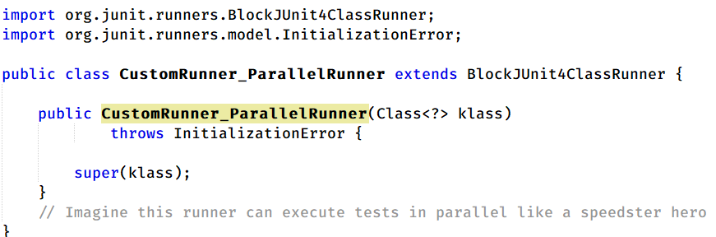

JUnit Custom Runners Example
The JUnit code defines a custom runner named `ParallelRunner`.
The name suggests that this runner can execute tests in parallel, akin to a speedy superhero.
Custom runners in JUnit can extend classes like `BlockJUnit4ClassRunner` to modify test execution behavior.
Generated By Copilot

Slide 30
Best Practices and Tips for Writing Effective Tests
Embrace the KISS (Keep It Simple, Superhero) : Write tests that are easy to understand and maintain.
One Villain at a Time: Each test should check only one specific issue.
Expect the Unexpected: Use @ExpectedException wisely to anticipate and handle evil surprises.
Follow the AAA (Arrange, Act, Assert) : A pattern for clear and consistent test structure.
Test Names: Use descriptive and meaningful test names to enhance readability.
Pay attention: Treat test code with the same care and attention as production code.

Slide 31
05
DO NOT SLEEP !!!!!!
Testing a real application

Slide 32
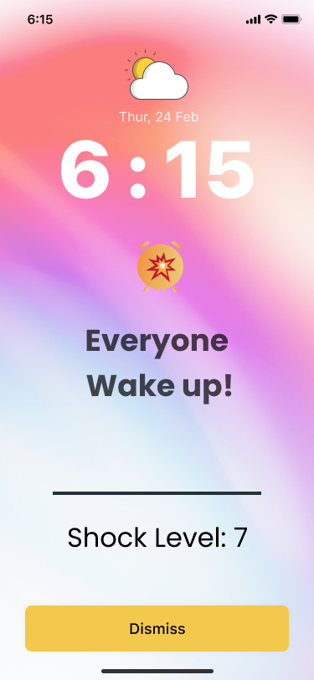
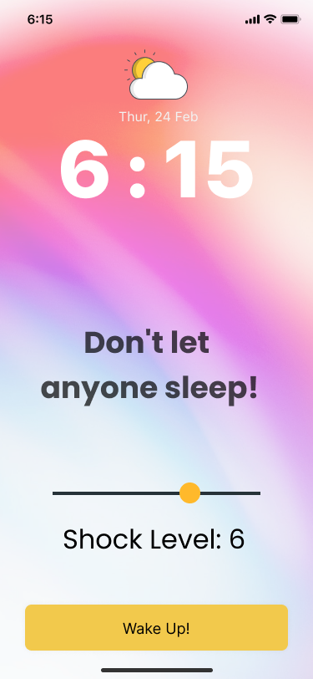
Testing a real application
The application belongs to the professors
when they click on the button, a terrible loud sound is spread throughout the classroom
It wakes up the students.

Slide 33
Java Application
public class DontSleep {
private boolean isAwake;
private int shockLevel;
public DontSleep() {
isAwake = false;
shockLevel = 0;
}
public void wakeUp(int level) {
if (level >= 5) {
isAwake = true;
shockLevel = level;
PlaySound();
}
}
public boolean isAwake() {
return isAwake;
}
public int getShockLevel() {
return shockLevel;
}
}
public void PlaySound(){ //set up MediaPlayer
MediaPlayer mp = new MediaPlayer();
try {
mp.setDataSource(path+fileName);
mp.prepare();
mp.start();
}
catch (Exception e) { e.printStackTrace();
}
}

Slide 34
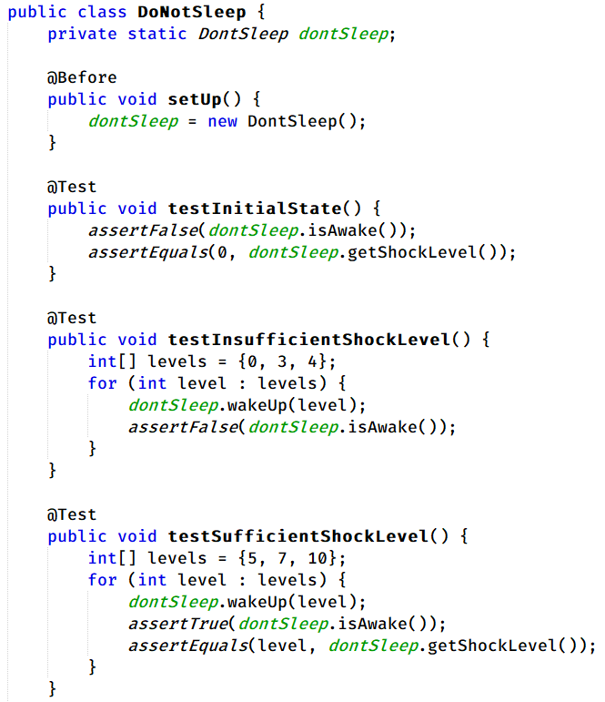
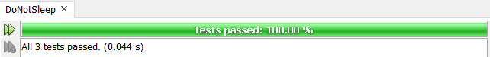
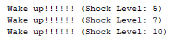
Test Case

Slide 35
The test class is named `DoNotSleep` and it tests the functionality of the `DontSleep` class.
The `@Before` annotation is used to set up the test environment before each test method is executed. It creates a new instance of the `DontSleep` class.
The `testInitialState` test method:
- Checks that the initial state of the `DontSleep` object is correct.
- Asserts that `isAwake()` returns `false`, indicating that the person is not awake initially.
- Asserts that `getShockLevel()` returns `0`, indicating that the initial shock level is zero.

Slide 36
The `testInsufficientShockLevel` test method:
Tests the behavior when the shock level is insufficient to wake up the person.
Uses an array of shock levels `{0, 3, 4}` that are below the threshold of 5.
Iterates over each shock level and calls the `wakeUp()` method with that level.
Asserts that `isAwake()` returns `false` for each shock level, indicating that the person is still not awake.

Slide 37
The `testSufficientShockLevel` test method:
Tests the behavior when the shock level is sufficient to wake up the person.
Uses an array of shock levels `{5, 7, 10}` that are equal to or above the threshold of 5.
Iterates over each shock level and calls the `wakeUp()` method with that level.
Asserts that `isAwake()` returns `true` for each shock level, indicating that the person is awake.
Asserts that `getShockLevel()` returns the corresponding shock level for each case.

Slide 38
The test class ensures that the `DontSleep` class behaves correctly by testing different scenarios:
The initial state of the object is correct.
Insufficient shock levels do not wake up the person.
Sufficient shock levels wake up the person and update the shock level accordingly.

Slide 39
06
Wrap-Up & Resources
Conclusion & Resources

Slide 40
Conclusion
JUnit is a crucial tool for Java developers, enabling efficient testing practices and fostering the development of reliable software.
It aids in maintaining code quality and ensuring the functionality of projects.
The framework catches bugs early and provides a safety net for code changes.
JUnit revolutionizes unit testing in Java, influencing testing methodologies in software development.
Encourages a rigorous and continuous testing regime, enhancing software quality and reliability.

Slide 41
Pragmatic Unit Testing in Java with JUnit
Resources
Online Course: "Test-Driven Development with JUnit" on Udemy
Official JUnit Website:
JUnit.org
"JUnit in Action" by Vincent Massol, Ted Husted, and Craig C. McDaniel
GitHub Repositories
Stack Overflow

Slide 42


Thanks!
Do you have any questions?
aliimanifard13@gmail.com
@aliimanifard
linkedin.com/in/aliimanifard
Copyright © AliImanifard 2024
All rights reserved. This presentation and its content are protected by copyright laws. Unauthorised use or reproduction of any part of this presentation without prior written permission is strictly prohibited.

